Slide 1
MODULE -4
Hashing – Static Hashing

Slide 2
Why Hashing?
In huge databases it is very impractical to search all the index values to get the desired data as searching all the index values through all the levels is not an efficient way to reach destination data block to retrieve the desired data.
So we need an efficient technique

Slide 3
What is Hashing?
Hashing is a method for calculating the direct position of an information record on the disk without the use of an index structure.
It is an effective technique with less search time
It uses a hash function (a mathematical function) to find the exact location of a record in the minimum amount of time.

Slide 4
Some important Terminologies
Data buckets are the memory locations where the actual data records are stored.
Hash function - A mathematical function that returns the value of the address of the desired data block. Mostly, it uses the primary key to generate the address of a data block.
Hash index - It denotes the address of a data block generated by the hash function.
Linear Probing - It is used when a record already exists on the memory location calculated by Hash Function. It linearly searches for an empty bucket until it is found.

Slide 5
Some important Terminologies
Quadratic Probing - It is similar to linear probing with the only difference as it uses an arbitrary polynomial function to search for the next empty bucket instead of searching linearly.
Bucket overflow - The condition when the memory address generated by the hash function is not empty(i.e. it already contains some data record) is known as bucket overflow
Notes:
A polynomial function is a function that involves only non-negative integer powers or only positive integer exponents of a variable in an equation like the quadratic equation.

Slide 6
Properties of Hashing in DBMS
Data is kept in data blocks whose addresses are produced using the hashing function.
Data buckets or data blocks are the memory locations where these records are stored.
A hash function can produce the address from any column value.
The primary key is frequently used by the hash function to generate the data block’s address.
To every complex mathematical function, a hash function is a basic mathematical function.
The primary key can also be considered as the data block’s address, i.e. each row with the same address as a primary key contained in the data block.

Slide 7
Hash Function
The hash function:
must be simple to compute.
must distribute the keys evenly among the cells.
If we know which keys will occur in advance we can write perfect hash functions, but we don’t.

Slide 8
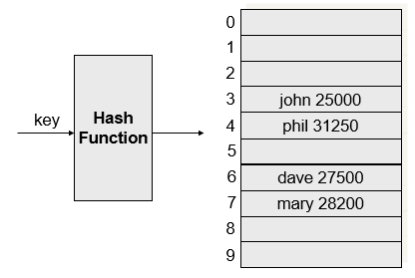
Example

Slide 9
Properties of Good Hash Functions
Must return number 0, …, table size
Should be efficiently computable – O(1) time
Should not waste space unnecessarily
For every index, there is at least one key that hashes to it
Load factor lambda λ = (number of keys / Table Size)
Should minimize collisions
= different keys hashing to same index
Hash(x) = x % TableSize

Slide 10
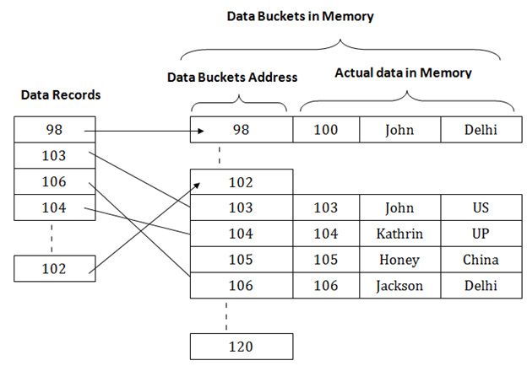
Hashing
The diagram shows data block addresses same as primary key value.

Slide 11
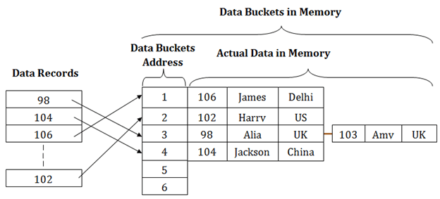
Hashing
The hash function could alternatively be a simple mathematical function, such as exponential, mod, cos, sin, and so on.
For example, the mod (5) hash function is used to find the data block’s address in the below scenario, here the primary keys are hashed with the mod (5) function, yielding 3, 3, 1, 4, and 2, respectively, and records are saved at those data block locations.

Slide 12
Hashing
Process of mapping a key value to a position in a table
0
1
2
3
4
5
6
7
8
9
41
34
7
18
Another Example: 7, 18 , 41 , 34
7 % 10 = 7
18 % 10 = 8
41 % 10 = 1
34 % 10 = 4

Slide 13
Hashing
Hash Table is an array of some fixed size
Search is performed based on the key
Each key is mapped into some position in the range 0 to table size - 1
Drawbacks:
Waste too much space, if universe is too large compared with actual number of elements to be stored
Collision {i.e. Two keys may hash to same slot}

Slide 14
Example: To insert elements 80 , 40 , 65 , 24 , 58 , 35 , 98
Table Size = 11
0
1
2
3
4
5
6
7
8
9
10
24
80
40
65
80 % 11 = 3
40 % 11 = 7
65 % 11 = 10
24 % 11 = 2
58 % 11 = 3
35 % 11 = 2
98 % 11 = 10
Collision

Slide 15
Collision in Hashing
A collision occurs when the hash field value of a record that is being inserted hashes to an address that already contains a different record.
In this situation, we must insert the new record in some other position, since its hash address is occupied.
The process of finding another position is called collision resolution.
There are numerous methods for collision resolution, including the following:
Open Addressing / Closed Hashing
Chaining / Separate chaining / Open Hashing
Multiple Hashing

Slide 16
Collision Handling Strategies
Separate Chaining
Open Addressing
Open Hashing
Closed Hashing
Linear Probing
Quadratic Probing
Double Hashing
Rehashing

Slide 17
Hashing Types
Static Hashing
Dynamic Hashing

Slide 18
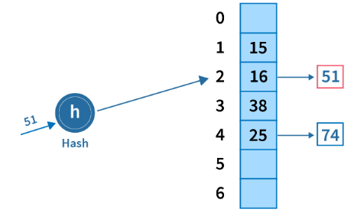
Types of Static Hashing
1. Open Hashing / Separate Chaining - In open hashing, the collision condition is handled by linking the new record after the previous one, due to which is also termed as "Hashing with separate chaining".
Here, when buckets are full, a new bucket is allocated for the same hash and result are linked after the previous one.

Slide 19
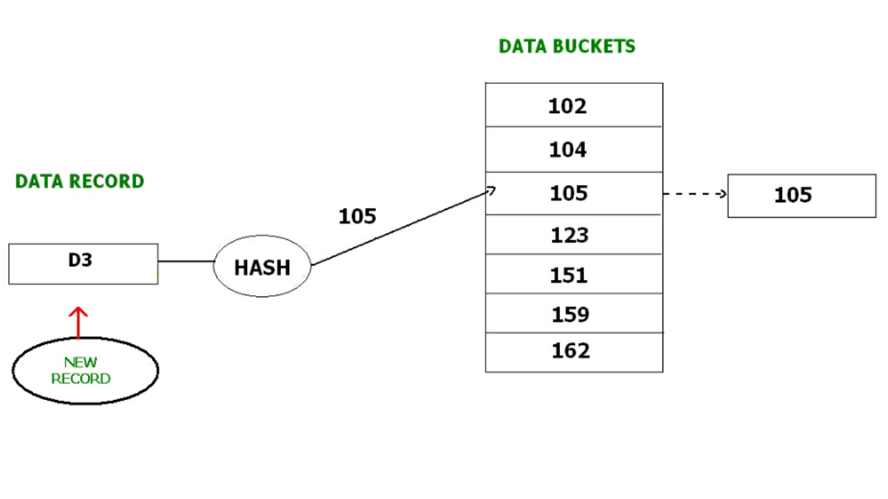
Separate Chaining
In this method, a new data bucket is allocated with same address and is linked it after the full data bucket. This method is also known as Separate / overflow chaining.
For example, we have to insert a new record D3 into the tables. The static hash function generates the data bucket address as 105. But this bucket is full to store the new data. In this case is a new data bucket is added at the end of 105 data bucket and is linked to it. Then new record D3 is inserted into the new bucket.

Slide 20
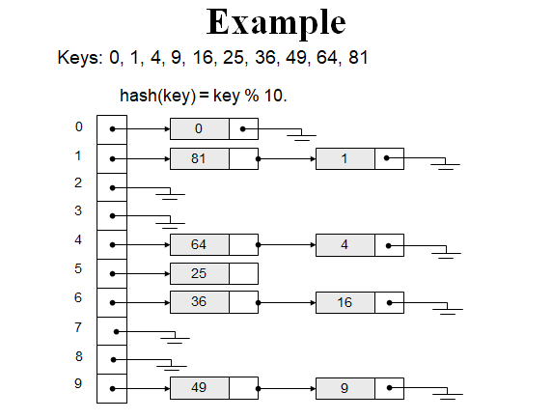
Separate Chaining Another Example

Slide 21
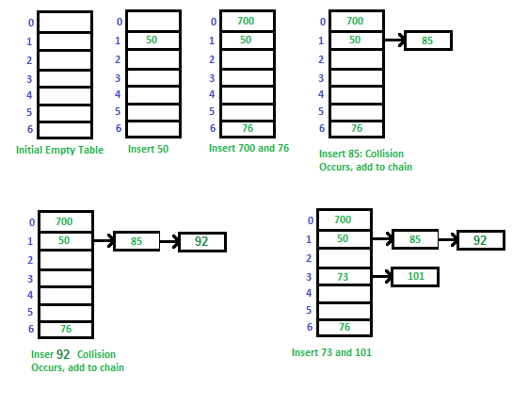
Example 2: Let us consider a simple hash function as “key mod 7” and sequence of keys as 50, 700, 76, 85, 92, 73, 101.

Slide 22
Advantages of Chaining
Simple to Implement
Separate chaining is a very simple technique to implement compared to other data structures. Input elements are just added to the corresponding linked list which the input has been hashed to. No collision occurs in the table as the cells hold linked information.
Hash Table Capacity not Limited
There is no issue with the table being filled to capacity, as the table cells only hold linked information. New elements are just added to the corresponding chain.
The hash table can be of theoretically infinite size
The hash table will not get polluted
When searching, it will never search irrelevant information.

Slide 23
Disadvantages
Chaining has the disadvantage of using linked lists.
Requires the implementation of a second data structure.

Slide 24
2. Static Hashing
In static hashing, for a key k, hash function h(x) always generates the same memory address. For example, if ℎ(x)=x%7 then for any x, the value will always be the same.
Thus if we generate the address for a key 107, then h(x) will always return the same bucket address, i.e., 2.
There will be no change in the bucket address. Hence the number of buckets in the memory always remains constant.
Collision Avoidance Methods: Linear Probing and Quadratic Probing

Slide 25
Operations in Static Hashing
Inserting a record: When a new record requires to be inserted into the table, you can generate an address for the new record using its hash key. When the address is generated, the record is automatically stored in that location.
Searching: When you need to retrieve the record, the same hash function should be helpful to retrieve the address of the bucket where data should be stored.
Delete a record: Using the hash function, you can first fetch the record which is you wants to delete. Then you can remove the records for that address in memory.

Slide 26
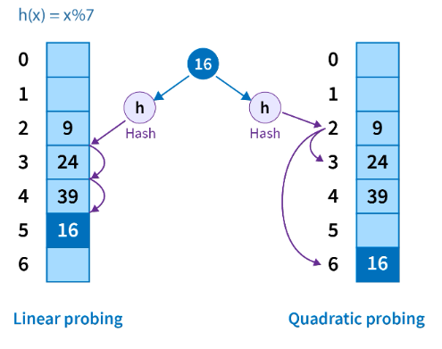
Types of Static Hashing
Open Addressing / Closed Hashing
In open addressing, whenever a collision occurs, we probe for the next empty bucket to enter the new record.
The order of checking are majorly of two types -
Notes:
Applications of linear probing: caching, Symbol tables, spell checking, compiler design
For quadratic probing, use mid-square method - we look for the i²‘th slot in the i^{th} iteration (hash(x): 1+1²)

Slide 27
Linear Probing
0
1
2
3
4
5
6
7
8
9
49
58
69
18
89
Example: 89 , 18 , 49 , 58 , 69
h ( k ) = k mod 10
89 % 10 = 9
18 % 10 = 8
49 % 10 = 9
58 % 10 = 8
69 % 10 = 9

Slide 28
Linear Probing
Linear probing is a form of open addressing.
In these schemes, each cell of a hash table stores a single key–value pair.
When the hash function causes a collision by mapping a new key to a cell of the hash table that is already occupied by another key, linear probing searches the table for the closest following free location and inserts the new key there.
h(x) =x mod size of array
if collision occurs
h(x) =[ h(x) +f(i)] mod size
where f(i)= i, where i =0,1,2,3,…

Slide 29
Linear Probing
In linear probing, collisions are resolved by sequentially scanning an array (with wrap around) until an empty cell is found.
i.e. f is a linear function of i, typically f(i)= i.

Slide 30
Drawbacks
Clustering of element in particular location .The time taken to check will be more.
Encounter Primary Clustering { blocks of contiguously occupied table entries}
Many consecutive elements form groups and it starts taking time to find a free slot or to search for an element.
If h( k ) falls in Cluster, Cluster will definitely grow in size by one
If two Cluster separated by one entry, inserting one key into cluster can merge two cluster, So cluster size increase drastically by single insertion
Large Cluster are easy targets for Collision

Slide 31
Drawbacks….
As long as table is big enough, a free cell can always be found, but the time to do so can get quite large.
Any key that hashes into the cluster will require several attempts to resolve the collision, and then it will add to the cluster
So to avoid this we go for quadrating probing

Slide 32
Quadratic Probing
h(x) =[ h(x) +f(i)] mod Table_size
where f(i)= i^2, where i =0,1,2,3,…
Main Idea: Spread out the search for an empty slot – Increment by i² instead of i
h_{i}(X) = (Hash(X) + i²) % Table Size , i=0,1,2,3…..,
h₀(X) = Hash(X) % Table Size
h₁(X) = [Hash(X) + 1] % Table Size
h₂(X) = [Hash(X) + 4] % Table Size
h₃(X) = [Hash(X) + 9] % Table Size

Slide 33
Quadratic Probing Example: insert 14,8,21,2,7 with size m=7
insert(14)
14%7 = 0
insert(8)
8%7 = 1
insert(21)
21%7 =0
insert(2)
2%7 = 2
0
14
0
14
0
14
0
14
1
1
8
1
8
1
8
2
2
2
2
2
3
3
3
3
4
4
4
21
4
21
5
5
5
5
6
6
6
6
1
1
3
1
probes:
Notes:
You can see that this works pretty well for an empty table and gets worse as the table fills up.
There’s another problem here. If a bunch of elements hash to the same spot, they mess each other up.
But, worse, if a bunch of elements hash to the same area of the table, they mess each other up! (Even though the hash function isn’t producing lots of collisions!)
This phenomenon is called primary clustering.

Slide 34
Problem With Quadratic Probing
insert(14)
14%7 = 0
insert(8)
8%7 = 1
insert(21)
21%7 =0
insert(2)
2%7 = 2
insert(7)
7%7 = 0
0
14
0
14
0
14
0
14
0
14
1
1
8
1
8
1
8
1
8
2
2
2
2
2
2
2
3
3
3
3
3
4
4
4
21
4
21
4
21
5
5
5
5
5
6
6
6
6
6
probes:
1
1
3
1
??
Notes:
You can see that this works pretty well for an empty table and gets worse as the table fills up.
There’s another problem here. If a bunch of elements hash to the same spot, they mess each other up.
But, worse, if a bunch of elements hash to the same area of the table, they mess each other up! (Even though the hash function isn’t producing lots of collisions!)
This phenomenon is called primary clustering.

Slide 35
Limitations:
In the above example the process is never ending and the no of probes increases, but to identify a cell and to store the element is not possible
In the case of quadratic probing, the situation is even more drastic.
There is no guarantee of finding an empty cell once the table gets more than half full, or even before the table gets half full if the table size is not prime.
So an empty key space can always be found as long as at most (n / 2), (with size of the table is n) locations are filled, i.e., the hash table is not more than half full.

Slide 36
Algorithm
Get the key hash key k
Set counter j = 0
3. Compute hash function h[k] = k % SIZE
4. If hash table[h[k]] is empty
(4.1) Insert key k at hash table[h[k]]
(4.2) Stop
Else
(4.3) The key space at hash table[h[k]] is occupied, so we need to find the next available key space
(4.4) Increment j
(4.5) Compute new hash function h[k] = ( k + j * j ) % SIZE
(4.6) Repeat Step 4 till j is equal to the SIZE of hash table
5. The hash table is full
6. Stop

Slide 37
Multiple Hashing / Double Hashing
Double hashing is a collision resolving technique in Open Addressed Hash tables. Double hashing uses the idea of applying a second hash function to key when a collision occurs.
This method applies a second hash function if the first results in a collision.
If another collision results, the program uses open addressing or applies a third hash function and then uses open addressing if necessary.
Double hashing can be done using :
(hash1(key) + i * hash2(key)) % TABLE_SIZE

Slide 38
Double Hashing
Here hash1() and hash2() are hash functions and TABLE_SIZE is size of hash table.
(We repeat by increasing i when collision occurs)
First Hash function : hash1(key) = key % TABLE_SIZE
Second Hash function : hash2(key) = PRIME – (key % PRIME)
where PRIME is a prime smaller than the TABLE_SIZE.
A good second Hash function is:
- It must never evaluate to zero
- Must make sure that all cells can be probed
Notes:
Idea: Spread out the search for an empty slot by using a second hash function

Slide 39
Double Hashing
Idea: Spread out the search for an empty slot by using a second hash function
No primary or secondary clustering
h_{i}(X) = (Hash₁(X) + i*Hash₂(X)) mod Table Size
for i = 0, 1, 2, …
Good choice of Hash₂(X) can guarantee does not get “stuck” as long as λ < 1
Integer keys: Hash₂(X) = R – (X mod R) where R is a prime smaller than Table Size
Notes:
λ - no. of keys / hash table size. If λ is less than 1, no problem otherwise go for rehashing.

Slide 40
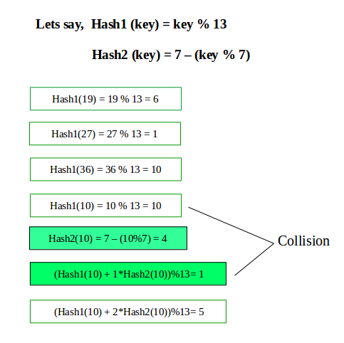
An Example

Slide 41
Example 2
insert(14)
14%7 = 0
insert(8)
8%7 = 1
insert(21)
21%7 =0
5-(21%5)=4
insert(2)
2%7 = 2
insert(7)
7%7 = 0
5-(7%5)=3
(0+1*4)%7=4
0
14
0
14
0
14
0
14
0
14
1
1
8
1
8
1
8
1
8
2
2
2
2
2
2
2
3
3
3
3
3
4
4
4
21
4
21
4
21
5
5
5
5
5
6
6
6
6
6
probes:
1
1
2
1
??
Notes:
You can see that this works pretty well for an empty table and gets worse as the table fills up.
There’s another problem here. If a bunch of elements hash to the same spot, they mess each other up.
But, worse, if a bunch of elements hash to the same area of the table, they mess each other up! (Even though the hash function isn’t producing lots of collisions!)
This phenomenon is called primary clustering.

Slide 42
Example 2
insert(14)
14%7 = 0
insert(8)
8%7 = 1
insert(21)
21%7 =0
5-1(21%5)=4
insert(2)
2%7 = 2
insert(7)
7%7 = 0 +
5-(7%5)=3
0
14
0
14
0
14
0
14
0
14
1
1
8
1
8
1
8
1
8
2
2
2
2
2
2
2
3
3
3
3
3
7
4
4
4
21
4
21
4
21
5
5
5
5
5
6
6
6
6
6
probes:
1
1
2
1
2
Notes:
You can see that this works pretty well for an empty table and gets worse as the table fills up.
There’s another problem here. If a bunch of elements hash to the same spot, they mess each other up.
But, worse, if a bunch of elements hash to the same area of the table, they mess each other up! (Even though the hash function isn’t producing lots of collisions!)
This phenomenon is called primary clustering.

Slide 43
Advantages:
Skip values give different search paths for keys that collide.
Disadvantage:
Delete cumbersome to implement

Slide 44
Example 3
Insert the following elements in the hash table of size 10.
3, 2, 9, 6, 11, 13, 12, 7
H1(k)= 2k+3 % tablesize
H2(k)=3k+1 % tablesize
When collision occurs use [U+i*V ] % m where U= h1(k) V=h2(k) and i= 0 to m-1

Slide 45
Home work : Hashing problem
Given the following input (3471, 1323, 6173, 4199, 4344, 9679,1989) and a hash function h(x)= x mod 10 show the resulting
A) Separate chaining hash table
B) Hash table using Linear Probing
C) Hash table using Quadratic Probing
D) Hash table with second Hash function
h₂(x) = 7- ( x mod 7 )

